Slide 1
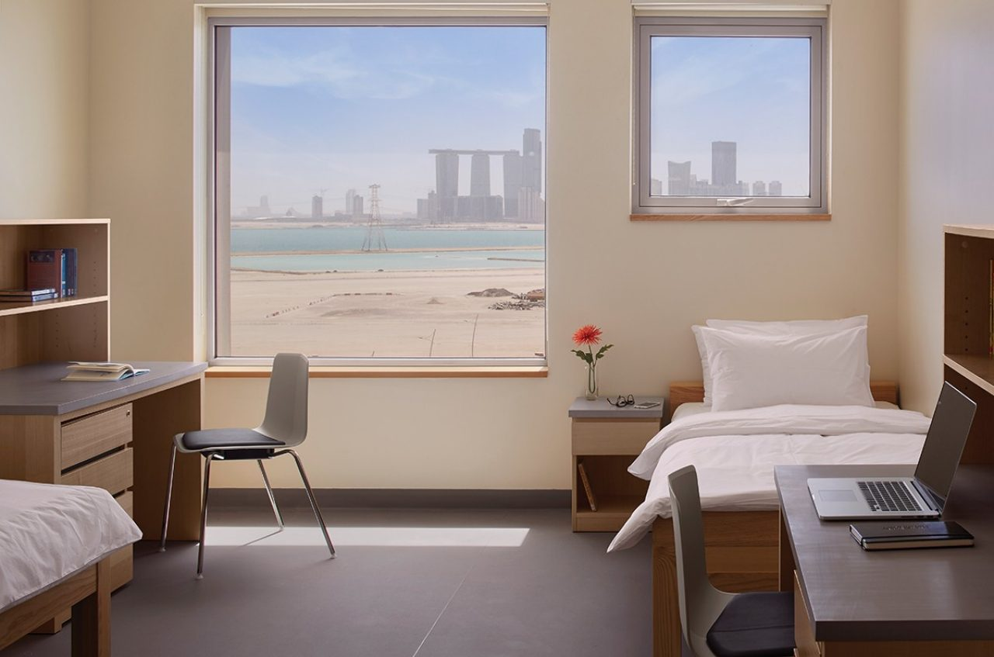

Room Manager
By Ruxandra Burian, Zichen Jing (Nancy), Jiwoo Lee, Afra Alhammadi, Renata Espinosa
by Ruxandra Burian, Zichen Jing (Nancy), Jiwoo Lee, Afra Alhammadi, Renata Espinosa

Slide 2
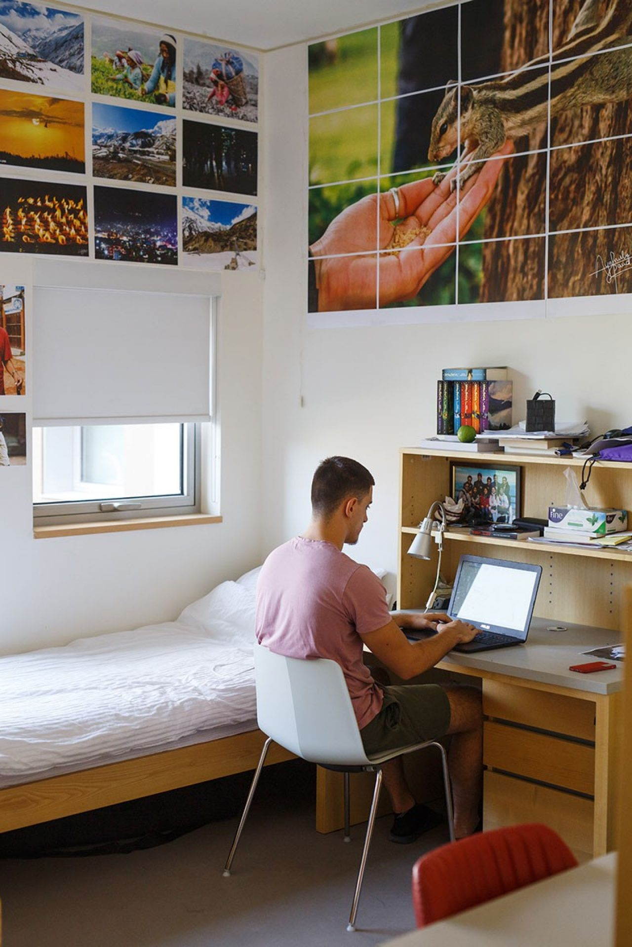
What is the problem?
Living alone with no bills might form the following habits:
Wasteful usage of energy
Living in an unhealthy environment

Slide 3
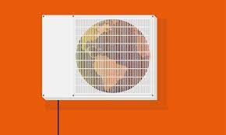

Primary Objective
To achieve sustainability, we aim to control the usage of air conditioner and light within our dorms. Moreover, this will encourage healthy consumption and prepare students for future living conditions.

Slide 4
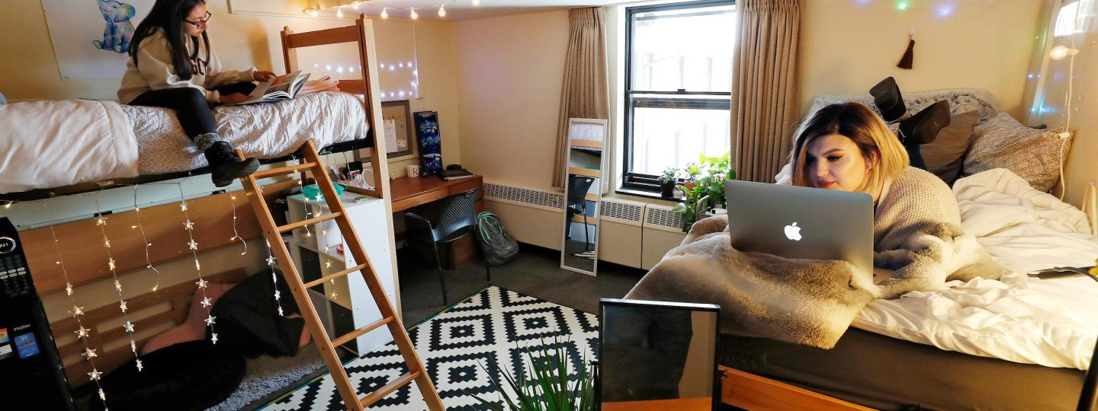
Secondary Objective
With this project, we also aim to coordinate roommate issues and maintain a harmonious dorm environment.
By keeping track of temperature and humidity (air conditioner and window opening), the device will be able to conserve a cozy dorm environment and provide data to solve more efficiently roomie disagreements.

Slide 5
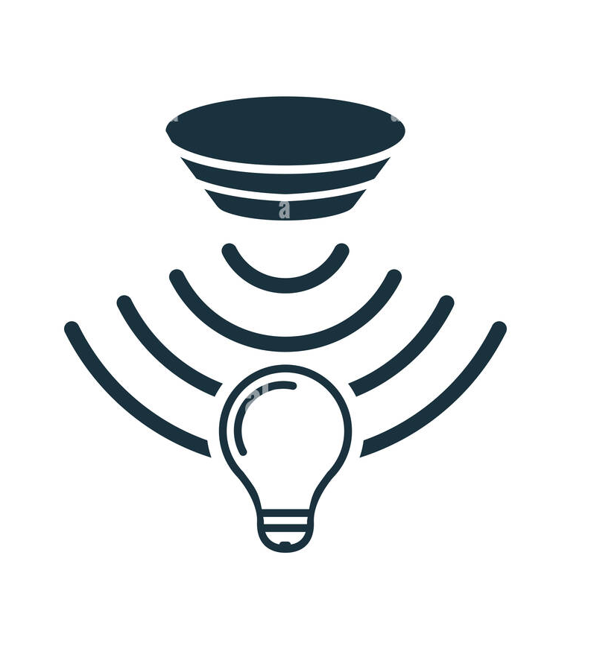
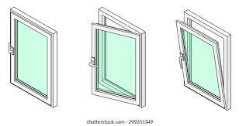
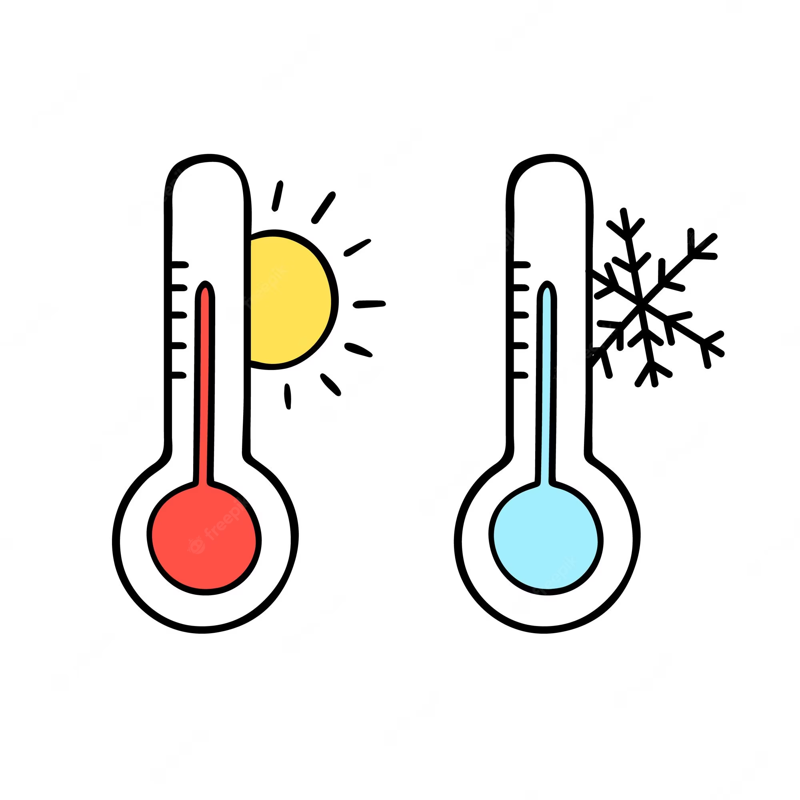
Functions
Lights on/off (light sensor)
Window open/close (humidity sensor)
Temperature (temperature sensor)
Notes:
Our Room Tracker device provides and displays data for many variables that go into sustainable room maintenance and also are a common cause of conflicts.
Our first function is detecting if the lights have been left on or off - which will be detected by a light sensor.
Our second function is determining if the window has been left open. Since the campus has a very noticeable difference in humidity inside and outside facilities. We can see the state of the window indirectly through humidity.
Our third function is measuring temperature through the temperature sensor,
Our fourth function is noise detection through the noise sensor,
And our last function is knowing the state of the door through an accelerometer.

Slide 6
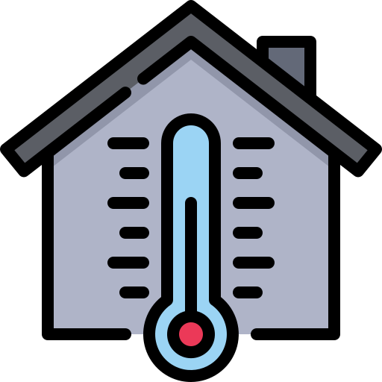
Walk through
Are you using more energy than is needed?
You can track your energy usage and the habitability of your room
The system will provide data by uploading the information to a website accessible from your phone.
When the set environmental conditions of the room have not been met for a determine period of time the LED of the object will turn red
Notes:
Having no idea what’s happening in your room while you are out can be stressful.
You either want to check your room’s temperature or humidity, if someone is invading your private space, or perhaps if the room’s door is open.
The system will provide you with this data by uploading the information to a website accessible from your phone.
When the set environmental conditions of the room have not been met for a determine period of time the LED of the object will turn red to prompt the user to check the website.

Slide 7

How does it encourage sustainability?
The display on your phone will calculate roughly how much energy you consume and whether you are living sustainably.
Not only tracks people usage of energy, but also encourages them to be more aware of it.
Notes:
Sustainability is not about withholding resources, but using a reasonable amount that is good for the environment → acceptable “range”.

Slide 8

What is the impact?
Beside bringing awareness to students it forms healthy habits.
Simulates living in the real world where you have to account for yourself.

Slide 9

We are looking forward to your feedback!

